Slide 1
Dynamic Programming
Ruichen Zhou

Slide 2
What is Dynamic programming
Dynamic Programming (DP) is an algorithmic technique for solving an optimization problem by breaking it down into simpler subproblems and utilizing the fact that the optimal solution to the overall problem depends upon the optimal solution to its subproblems.
记住求过的解来节省时间
1

Slide 3
Why and when Dynamic Programming
Dynamic Programming is mainly an optimization over plain recursion. Wherever we see a recursive solution that has repeated calls for same inputs, we can optimize it using Dynamic Programming. The idea is to simply store the results of subproblems, so that we do not have to re-compute them when needed later. This simple optimization reduces time complexities from exponential to polynomial.
适用于有重叠子问题和最优子结构性质的问题
2

Slide 4
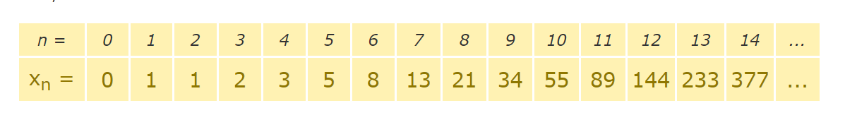
Example: Fibonacci numbers
The Fibonacci Sequence is the series of numbers:
0, 1, 1, 2, 3, 5, 8, 13, 21, 34, ...
What is Xₙ given value of n?
Leet509 https://leetcode.com/problems/fibonacci-number/
3

Slide 5
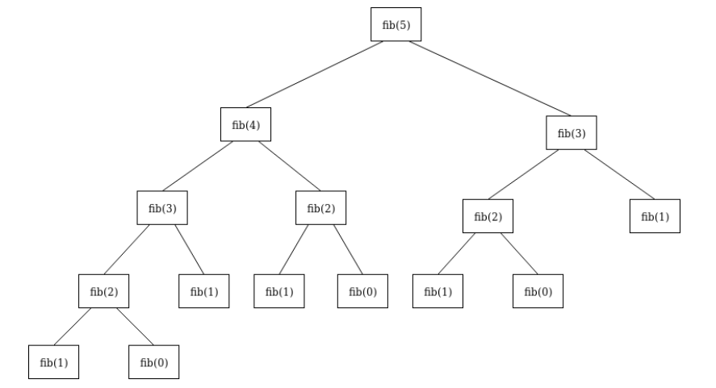
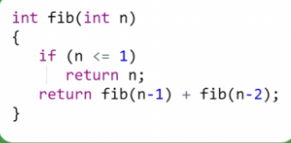
Recursive approach
4

Slide 6
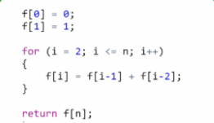
Dynamic approach
5

Slide 7
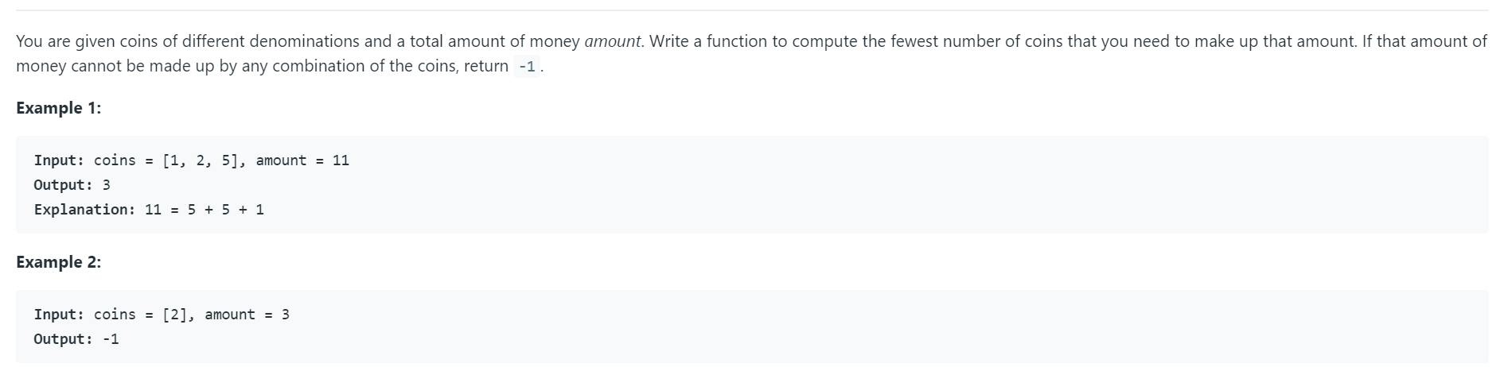
Coin change problem
Leet332 https://leetcode.com/problems/coin-change/ Leet518https://leetcode.com/problems/coin-change-2/
6

Slide 8
Fewest coins to make the amount
Coins: [1,2,5], amount = 11
Array | [0] | [1] | [2] | [3] | [4] | [5] | [6] | [7] | [8] | [9] | [10] | [11]
Coins | 0 | 1 | 1 | 2 | 2 | 1 | 2 | 2 | 3 | 3 | 2 | 3
Idea:
1. Make the DP array
Set value to amount+1
DP[i] = Math.min(DP[i],dp[i-coin]+1)
7

Slide 9
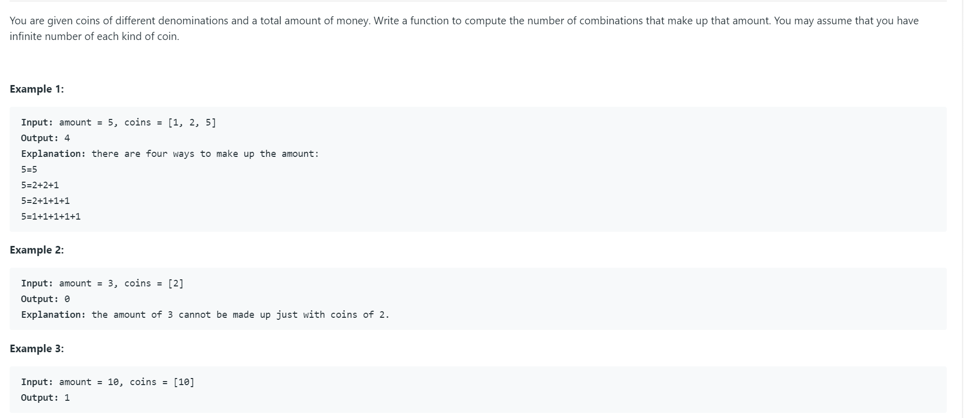
Coin change problem 2
Leet518 https://leetcode.com/problems/coin-change-2/
8

Slide 10
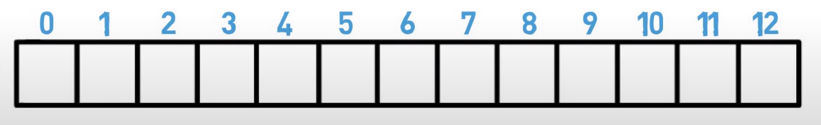
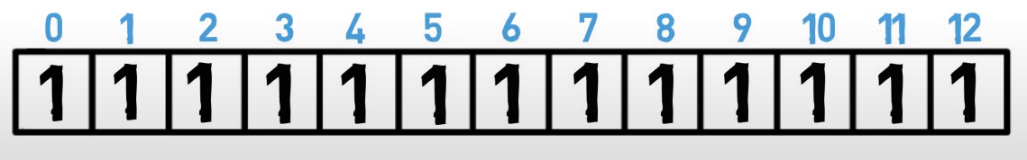
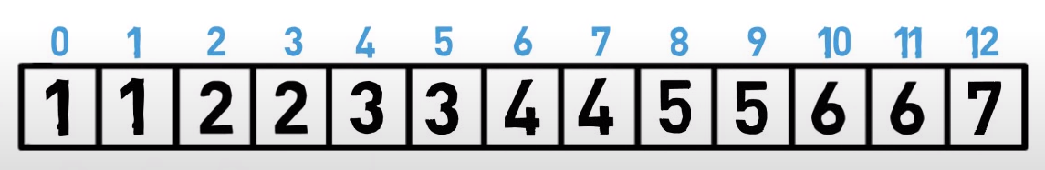
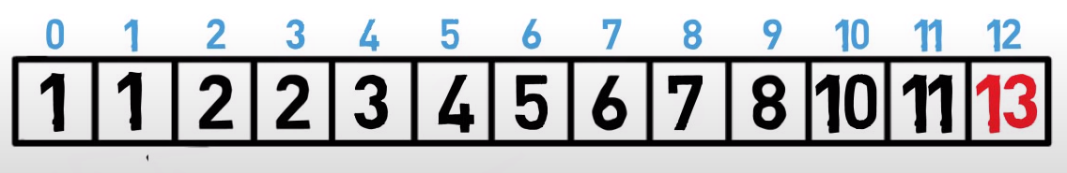
Number of ways to make the amount
Coins: [1,2,5], amount = 12
No coin:
1:
1,2:
1,2,5:
9

Slide 11
Logic behind
Main idea: for every coin: //1,2,5
For every amount: //0,1,2,3,4,5…
if(amount>coin){
Array[amount]+=Array[amount-coin];
}
10

Slide 12
Implementation
Coding in IDE
Given m = amount of money to make change for, n = number of coins provided
Big O analysis: Time? Space?
Time: O(m*n) Space: O(m)
11

Slide 13
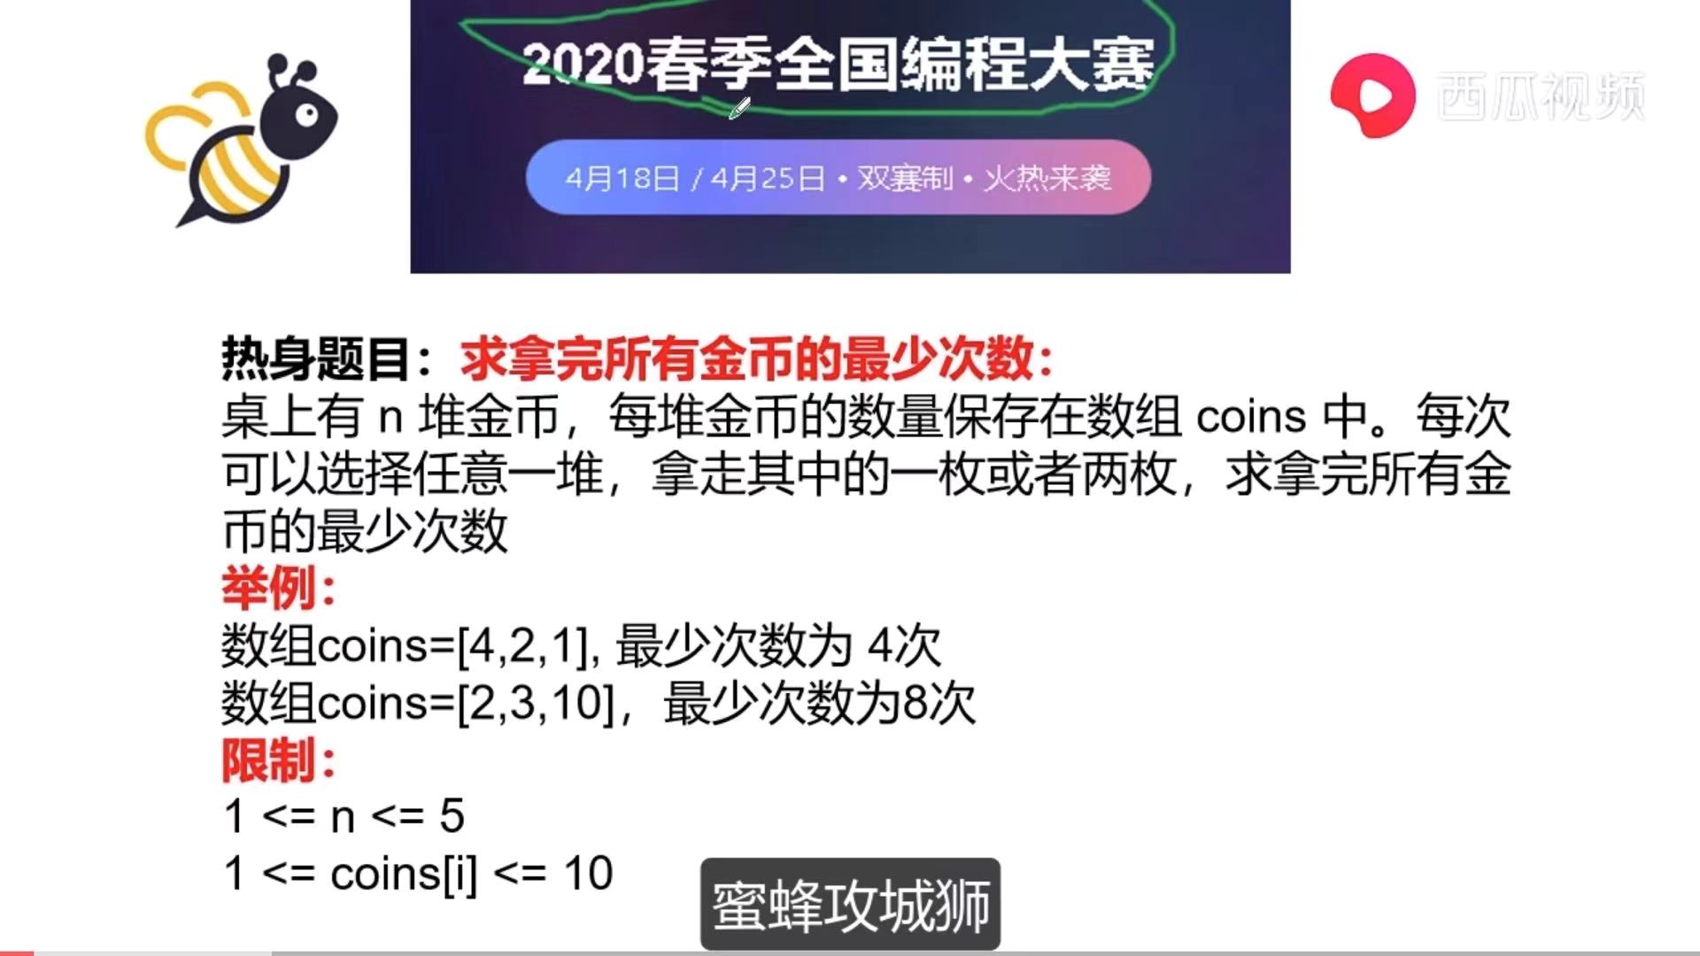
Exercise
Leet338: https://leetcode.com/problems/counting-bits/
Leet279: https://leetcode.com/problems/perfect-squares/
12

Slide 14
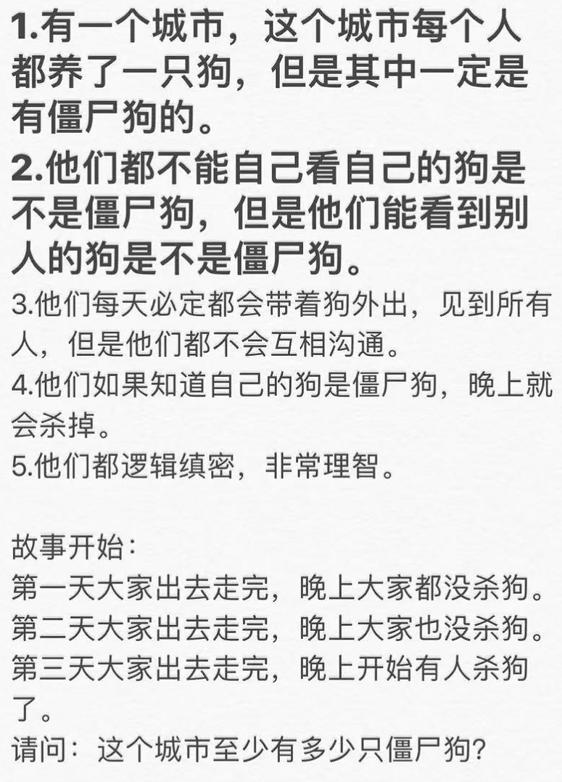
Brain Storm
13

Slide 15
THANK YOU

